Slide 1
GitHub Cheat codes

Slide 2
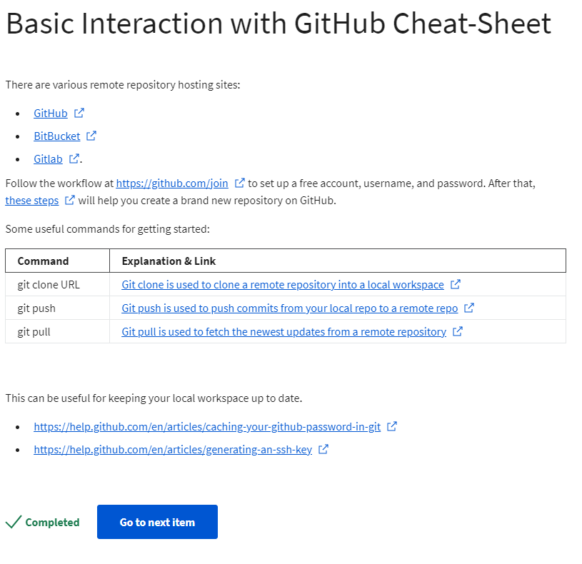
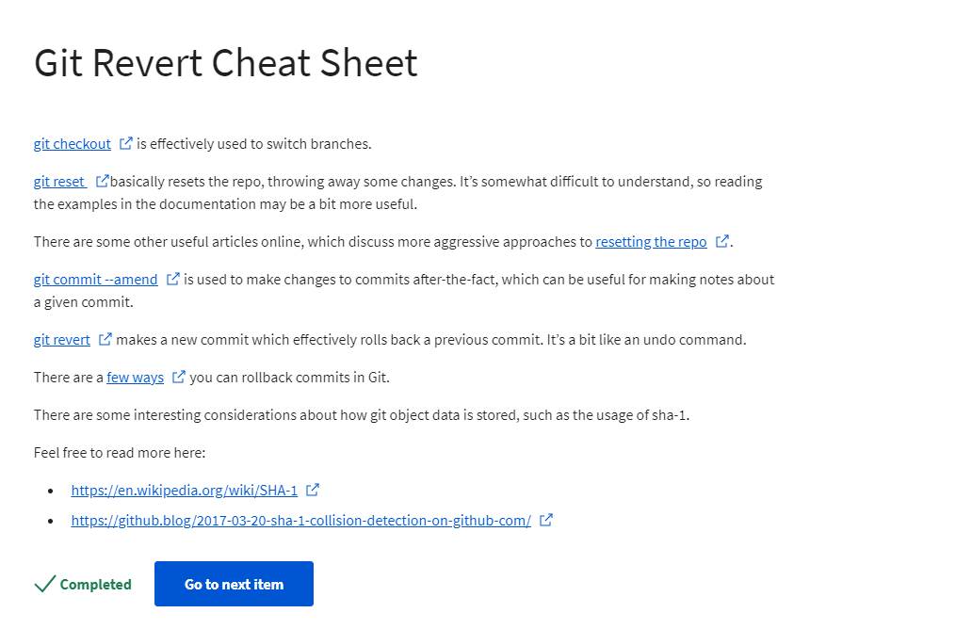

Slide 3
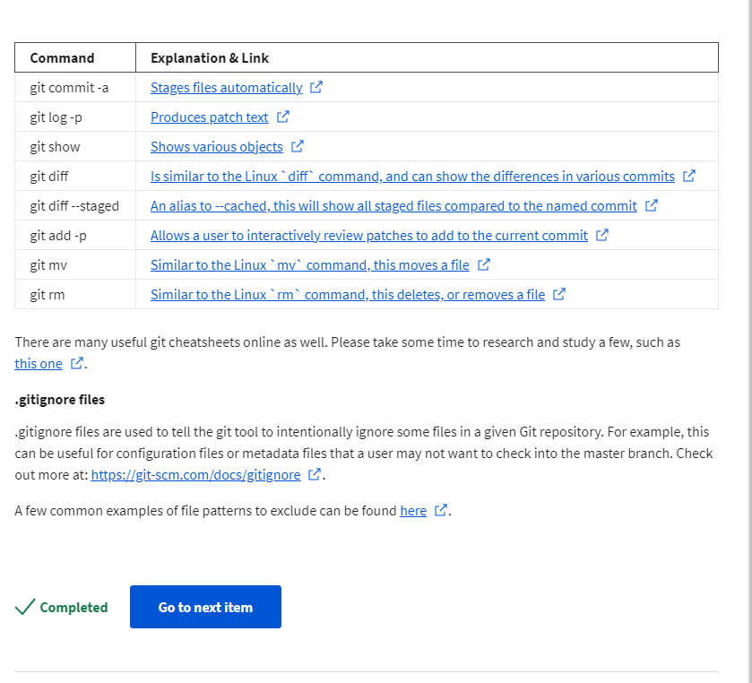
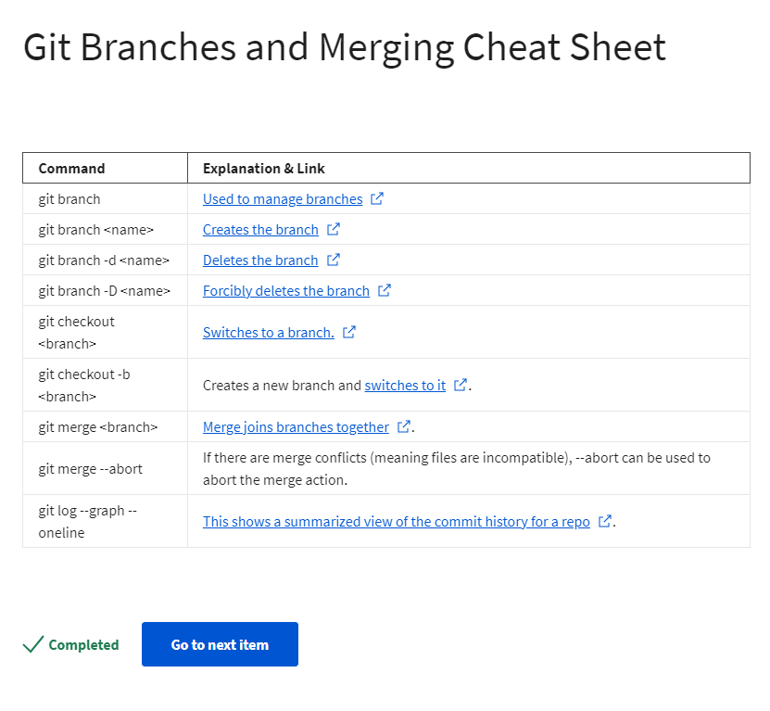

Slide 4
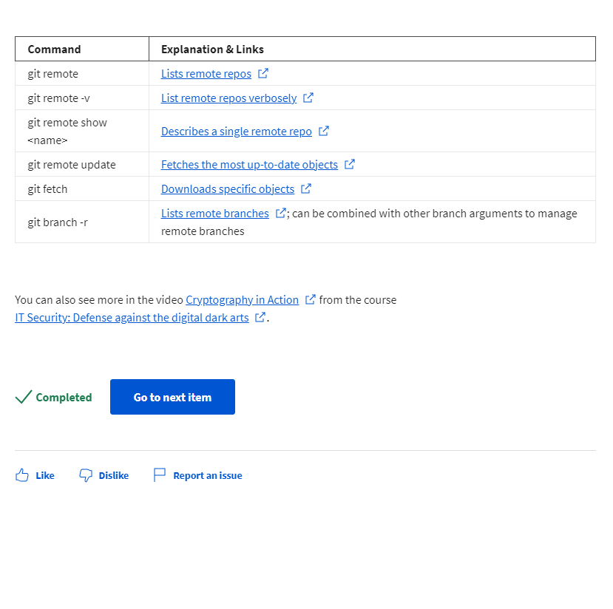

Slide 5
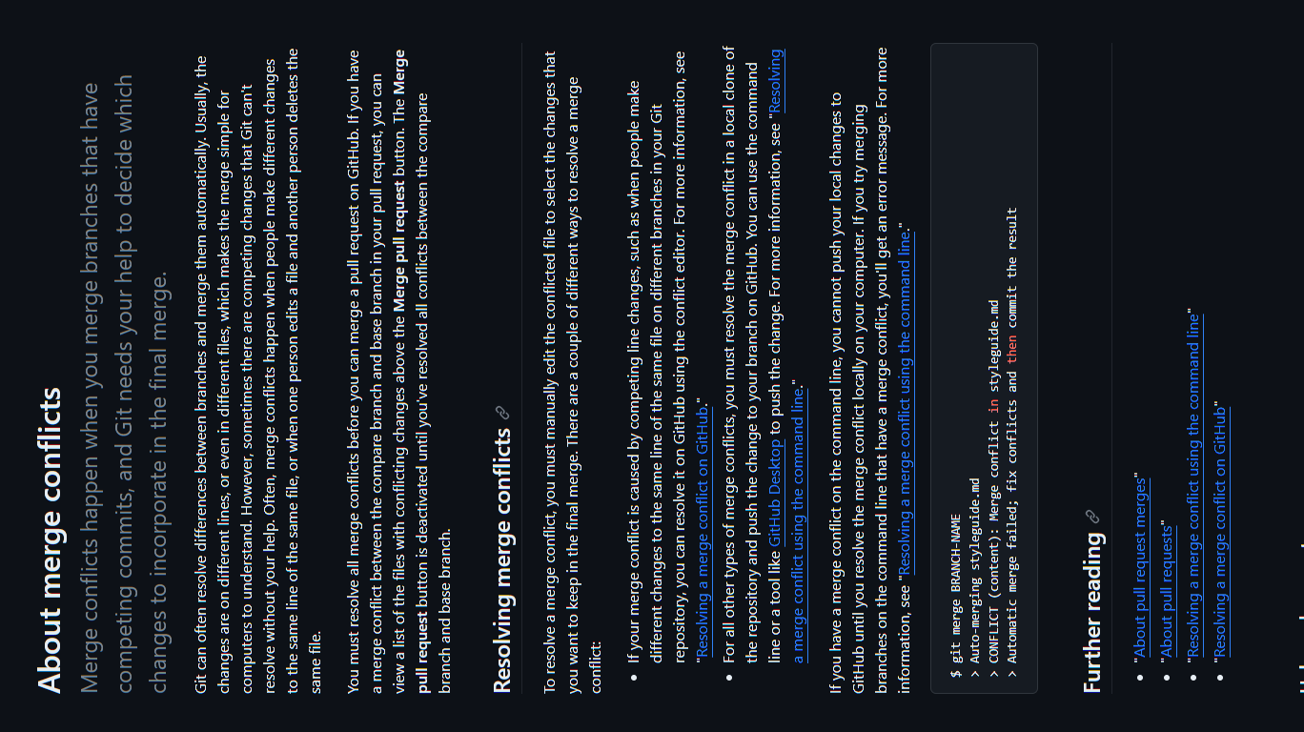

Slide 6
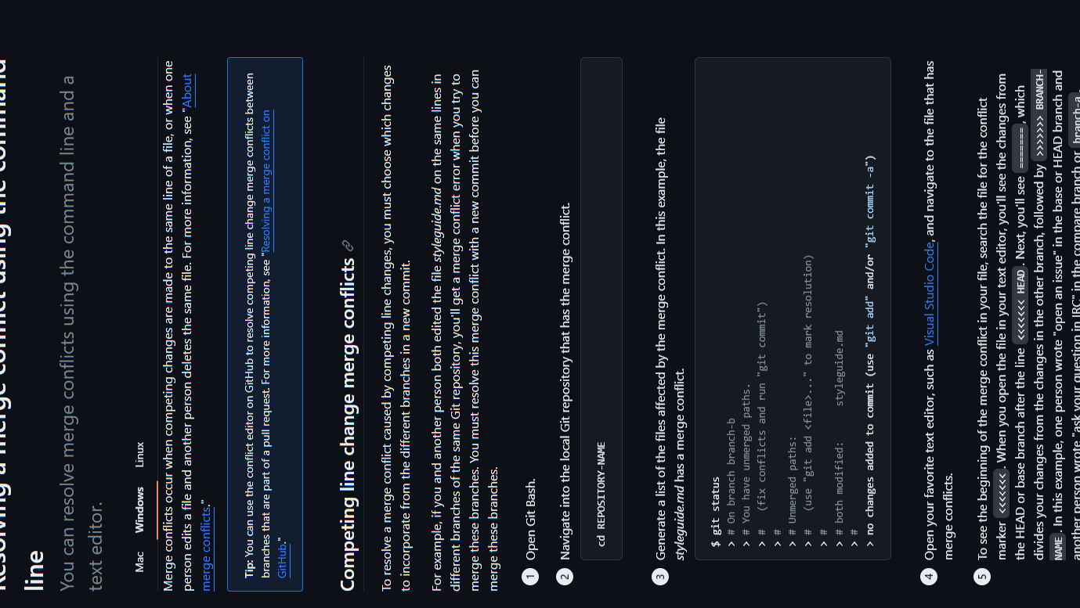

Slide 7
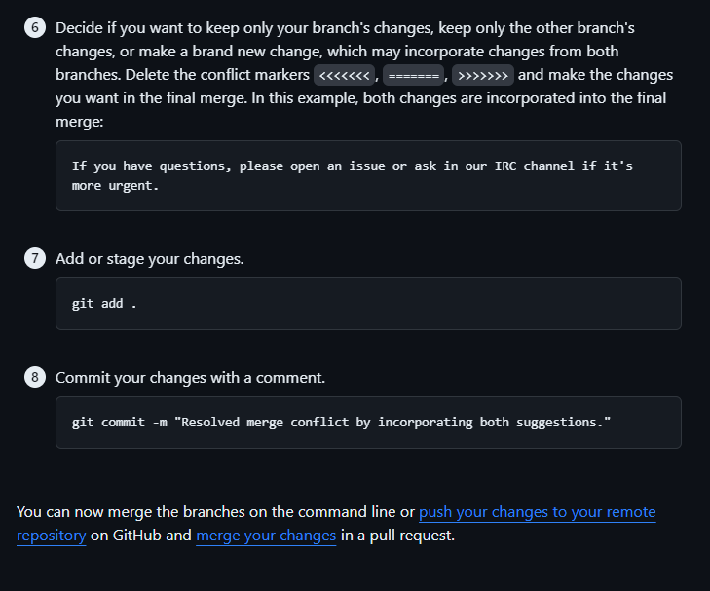

Slide 8
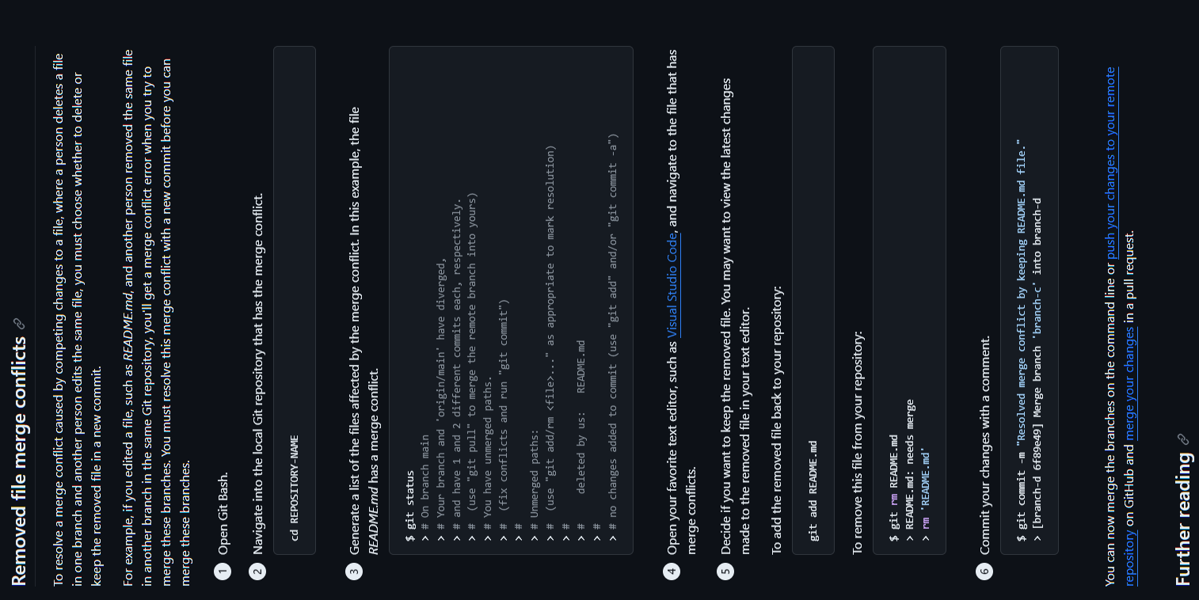

Slide 9
Code Review

Slide 10
https://google.github.io/styleguide/pyguide.html
https://google.github.io/styleguide/Rguide.html

Slide 11
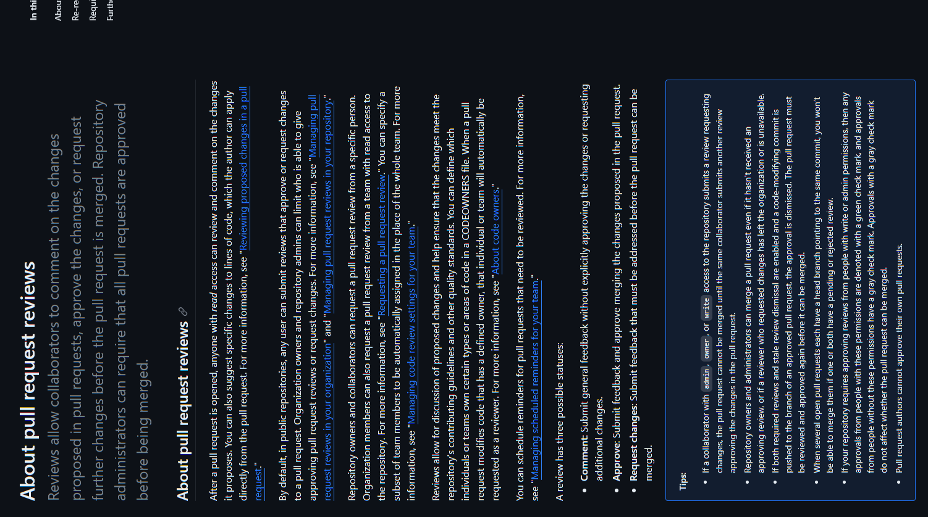

Slide 12
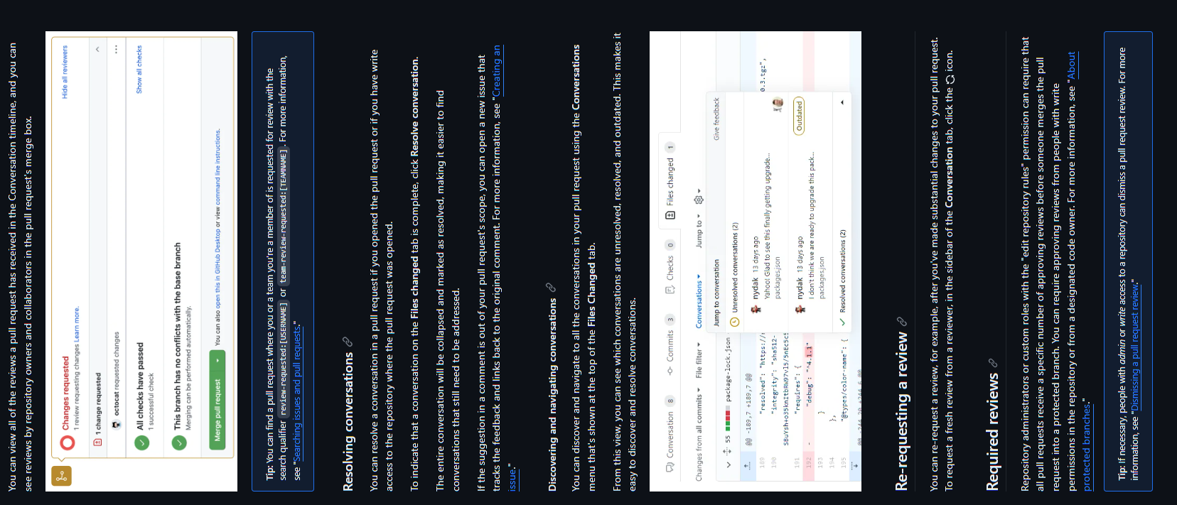

Slide 13
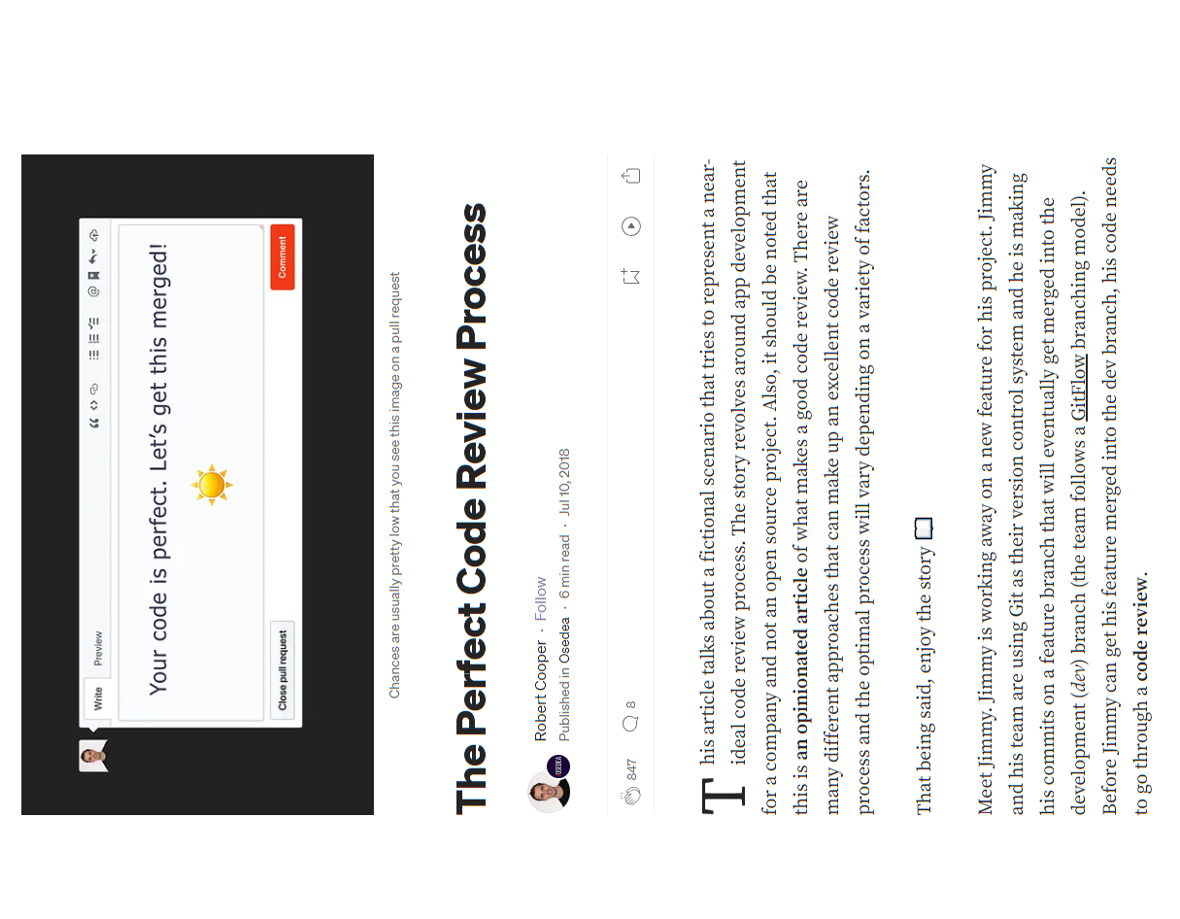

Slide 14
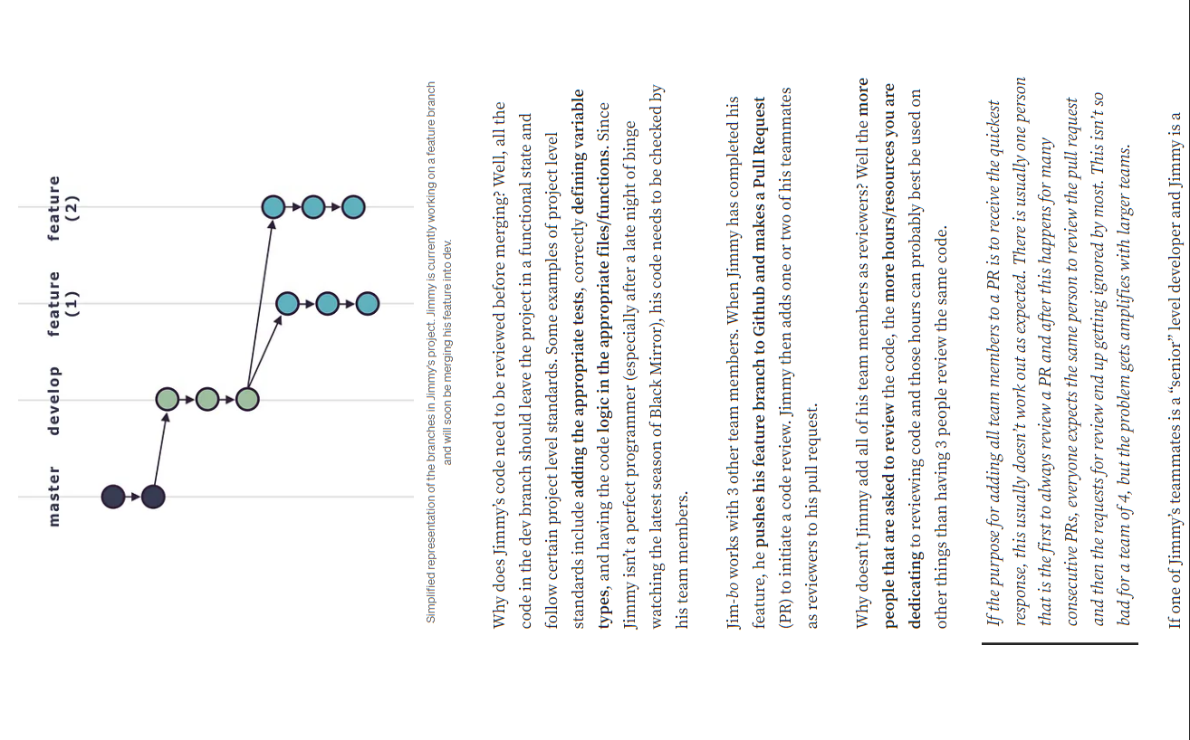

Slide 15
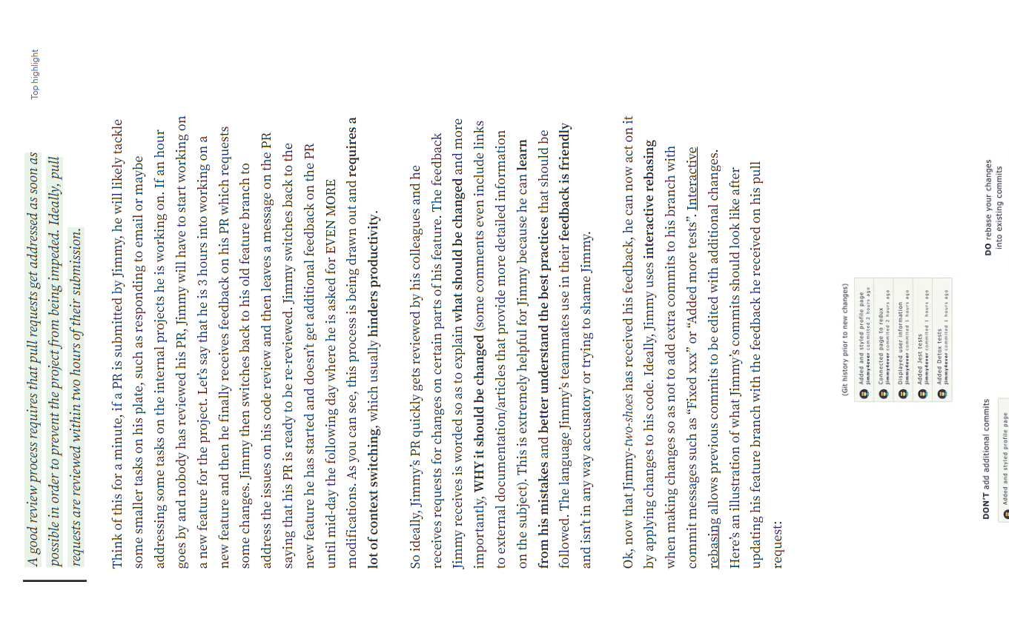
https://smartbear.com/learn/code-review/what-is-code-review/

Slide 16
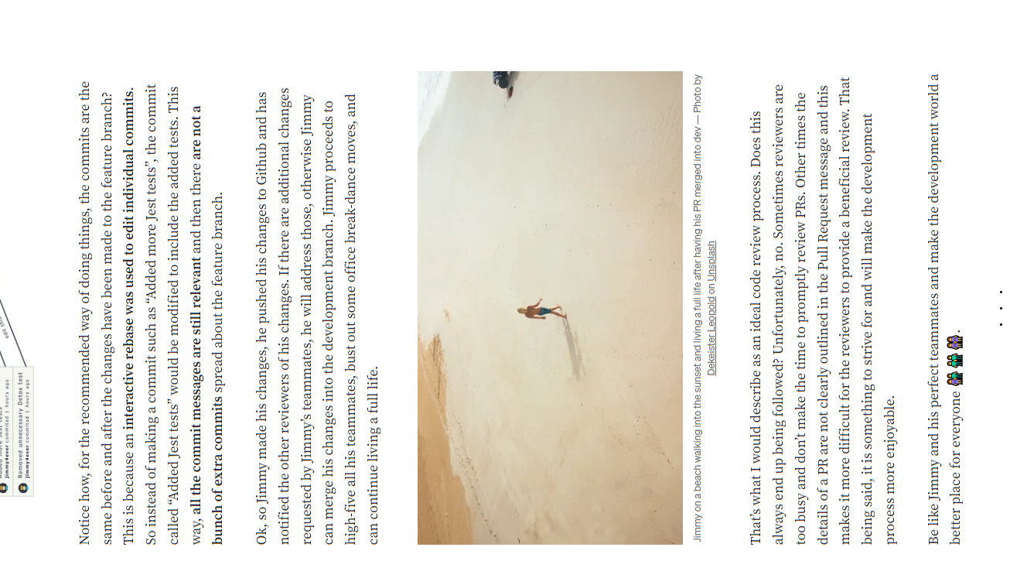

Slide 17
https://docs.github.com/en/issues/tracking-your-work-with-issues/linking-a-pull-request-to-an-issue
https://docs.github.com/en/issues/tracking-your-work-with-issues/linking-a-pull-request-to-an-issue
https://docs.github.com/en/communities/setting-up-your-project-for-healthy-contributions/setting-guidelines-for-repository-contributors
https://www.infoworld.com/article/3271126/what-is-cicd-continuous-integration-and-continuous-delivery-explained.html
https://stackify.com/what-is-cicd-whats-important-and-how-to-get-it-right/
https://docs.travis-ci.com/user/tutorial/
https://docs.travis-ci.com/user/build-stages/
https://docs.github.com/en/pull-requests/collaborating-with-pull-requests/incorporating-changes-from-a-pull-request/about-pull-request-merges

